Slide 1
Final Engagement
Attack, Defense & Analysis of a Vulnerable Network

Slide 2
Table of Contents
This document contains the following resources:
Network Topology & Critical Vulnerabilities
Exploits Used
Methods Used to Avoiding Detect

Slide 3

Network Topology
& Critical Vulnerabilities
3

Slide 4
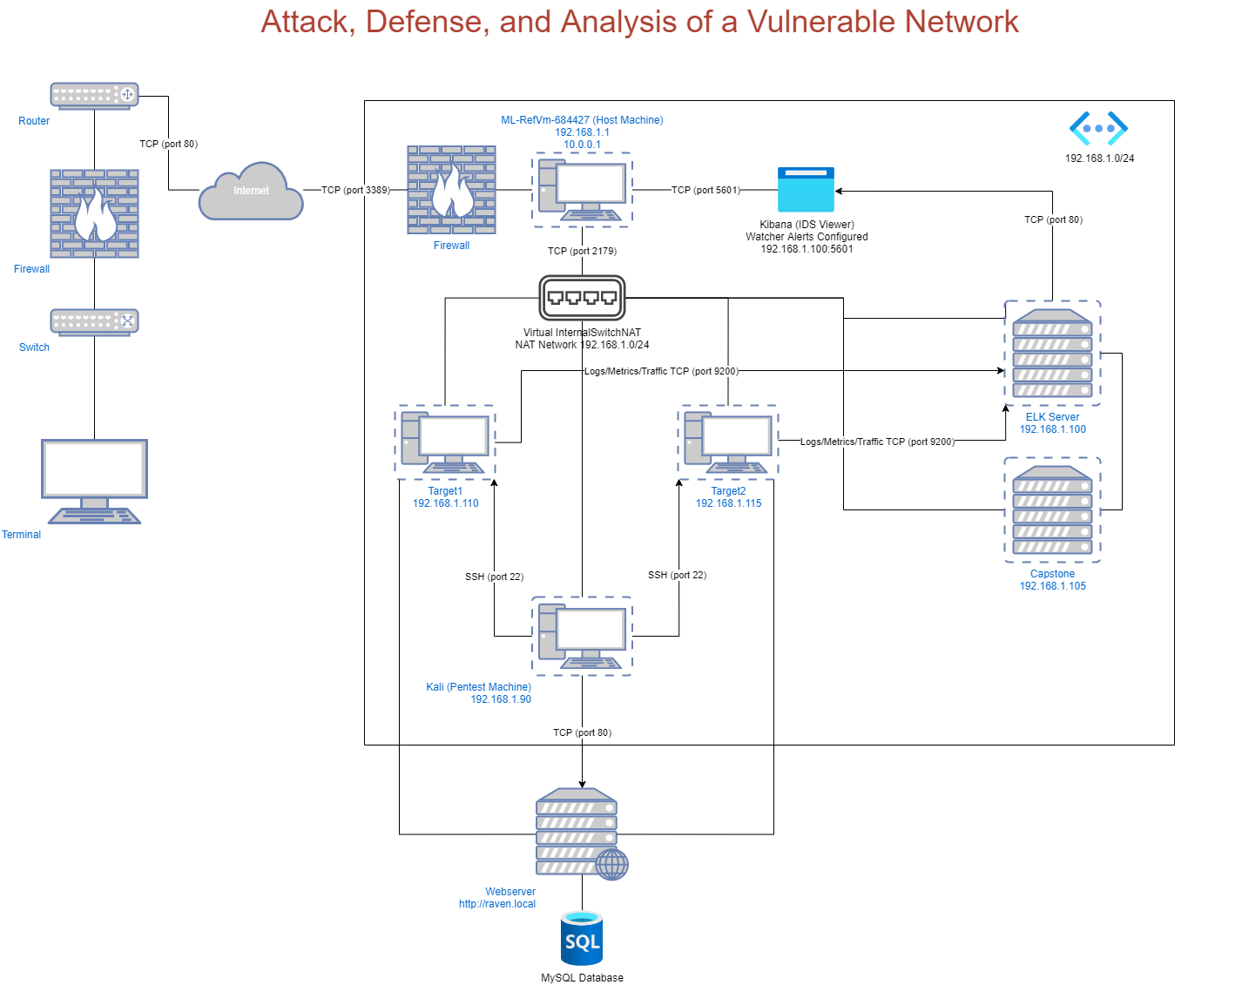
Network Topology
Network
Address Range: 192.168.1.0/24
Netmask: 255.255.255.0
Gateway: 10.0.0.1
Machines
IPv4: 192.168.1.90
OS: Kali Linux
Hostname: Kali
IPv4: 192.168.1.110
OS: Linux
Hostname: Target 1
IPv4: 192.168.1.105
OS: Linux
Hostname: Capstone
IPv4: 192.168.1.100
OS: Linux
Hostname: ELK

Slide 5
Critical Vulnerabilities: Target 1
Our assessment uncovered the following critical vulnerabilities in Target 1.
Vulnerability | Description | Impact
Weak Passwords | We used wpscan to enumerate users and used hydra/john to BruteForce | Due to weak passwords we were able to gain entry into the web server.
World Writable/Readable Files | Anyone can write and read the website files. | Led to discovery of database credentials and compromise of database.
No password on sudo –l for the /usr/bin/python directory for steven | Steven had sudo privileges to the python directory. | Sudo –l command provides a way to give a specific user permission to use specific system commands at the root level.

Slide 6
Critical Vulnerabilities: Target 2
Our assessment uncovered the following critical vulnerabilities in Target 2.
Vulnerability | Description | Impact
Wordpress | Wordpress version is vulnerable | Wordpress user and password enumeration is possible
PHPmailer –CVE-2016-10033 | PHP Automailer version is vulnerable to Anacoder | Backdoor injection is possible using reverse_tcp to establish a session
Clickjacking | Anti-clickjacking X-Frame-Options header is not present | Can redirect user to content they were not clicking
Cross Site Scripting | X-XSS-Protection header is not defined. | Injecting malicious script can be written in a comment or code in a trust site.

Slide 7
Exploits Used
7

Slide 8
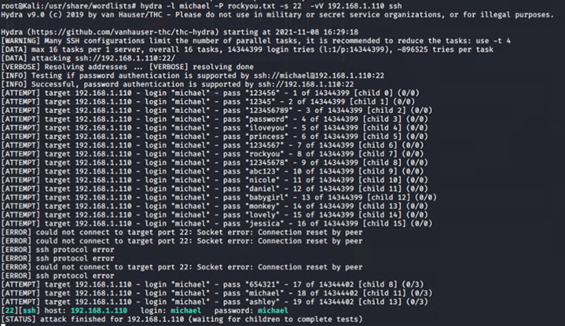
Exploitation: Weak Passwords
Summarize the following:
How did you exploit the vulnerability? E.g., which tool (Nmap, etc.) or technique (XSS, etc.)?
Wpscan for vulnerabilities. Found usernames and hash passwords. Used John to crack the passwords.
What did the exploit achieve? E.g., did it grant you a user shell, root access, etc.?
Wordpress gave us access to usernames and passwords.
Include a screenshot or command output illustrating the exploit.

Slide 9
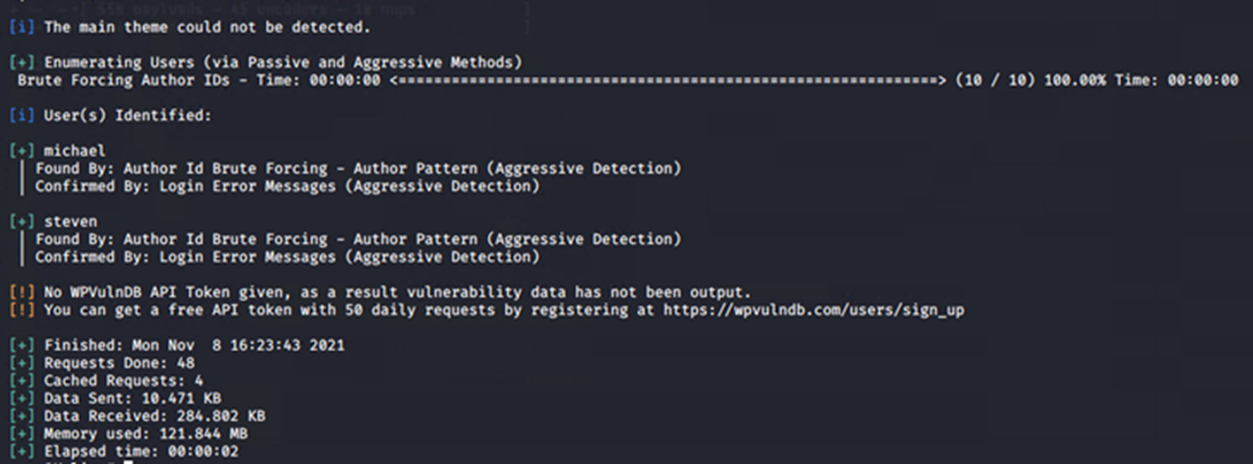
Exploitation: World Writable/Readable Files
Summarize the following:
How did you exploit the vulnerability? E.g., which tool (Nmap, etc.) or technique (XSS, etc.)?
Using Nmap we found the open port 80. We used wordpress to enumerate for the data.
What did the exploit achieve? E.g., did it grant you a user shell, root access, etc.?
It achieved getting the usernames and passwords to login as Michael and Steven.
Include a screenshot or command output illustrating the exploit.

Slide 10
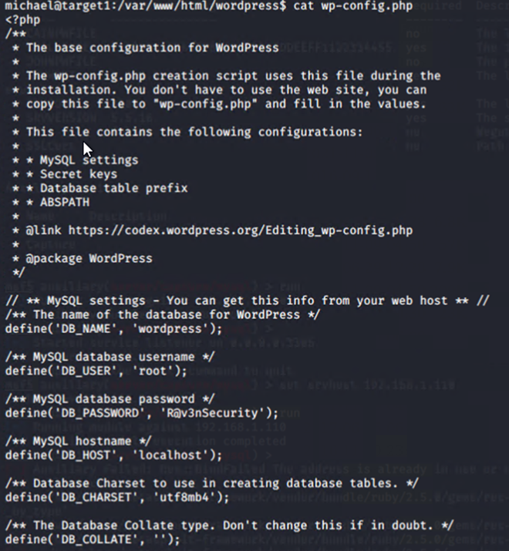
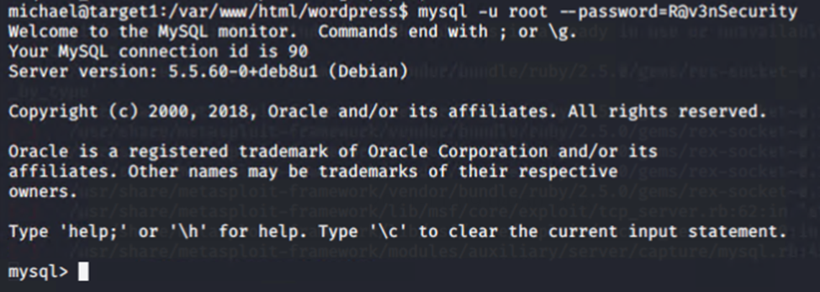
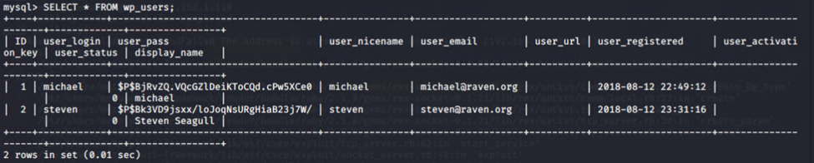
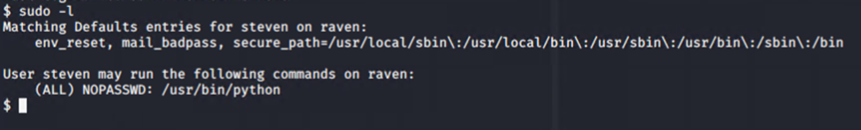
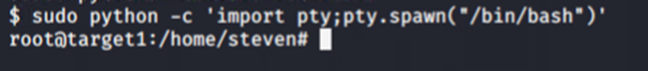
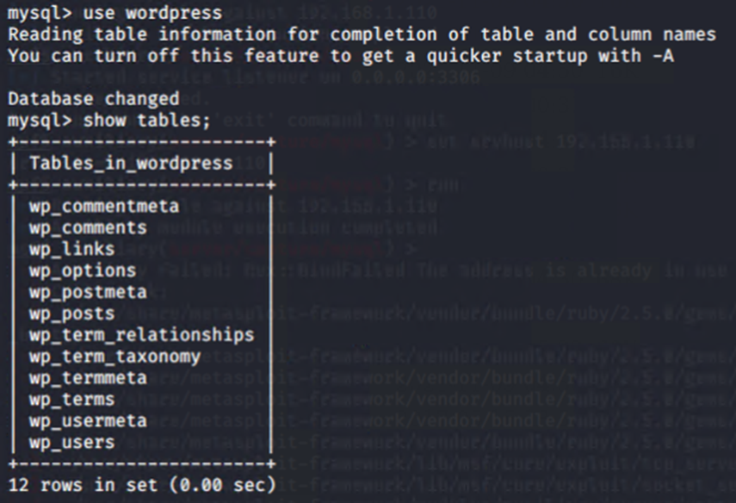
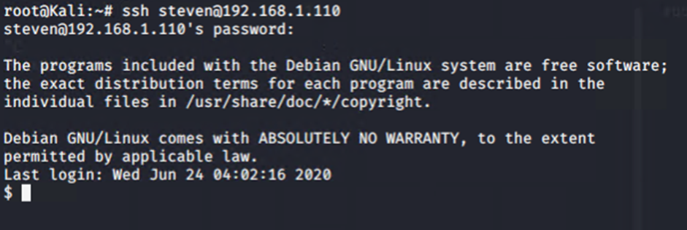
Exploitation: mysql
Summarize the following:
How did you exploit the vulnerability? E.g., which tool (Nmap, etc.) or technique (XSS, etc.)?
With the username and password from /var/www/html/wordpress/wp_config.php we used the credentials to log into mysql and view the database users and posts which revealed the user steven.
What did the exploit achieve? E.g., did it grant you a user shell, root access, etc.?
The exploit achieved access to stevens account which we then utilized to gain root access.
Include a screenshot or command output illustrating the exploit.

Slide 11
Avoiding Detection
11

Slide 12
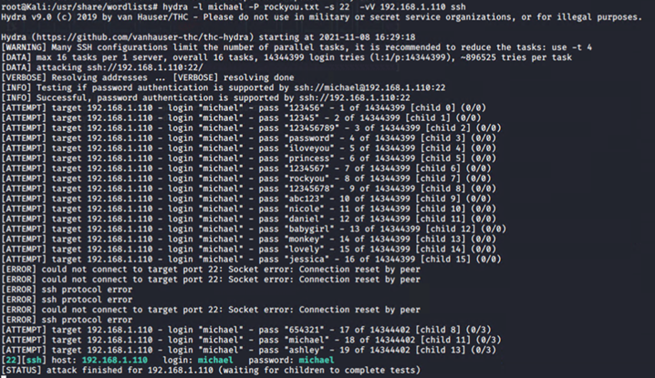
Stealth Exploitation of SSH
Monitoring Overview
Which alerts detect this exploit?
Excessive HTTP Errors
Which metrics do they measure?
Measures status codes. Can be configured to analyze certain ports, in this case port 22. Alerts to Brute Force Attack.
Which thresholds do they fire at?
Above 400 for the last 5 minutes.
Mitigating Detection
How can you execute the same exploit without triggering the alert?
Write a script that tells the password cracker to go to sleep for a certain amount of time before initiating again.
Are there alternative exploits that may perform better?
Performing offline bruteforce password cracking.
If possible, include a screenshot of your stealth technique.

Slide 13
Stealth Exploitation of HTTP
Monitoring Overview
Which alerts detect this exploit?
HTTP Request Size Monitor
Which metrics do they measure?
This alert measures http request bytes. Alerts to DDoS.
Which thresholds do they fire at?
Above 3500 bytes in 1 minute.
Mitigating Detection
How can you execute the same exploit without triggering the alert?
Send smaller packet sizes. (under 2500)
Are there alternative exploits that may perform better?
ICMP Flood requests overloads the webserver with IP pings without waiting for replys.
If possible, include a screenshot of your stealth technique.
Screenshot can not be provided due to breaking the VM when successfully executing. hping --icmp --flood --rand-source -p 22 192.168.1.110

Slide 14
Stealth Exploitation of mysql
Monitoring Overview
Which alerts detect this exploit?
CPU Usage Monitor
Which metrics do they measure?
This measures system.process.cpu.total.pct. This shows spikes in activities of a computer when an action is taking place.
Which thresholds do they fire at?
This alert fires above 50% usage of database resources.
Mitigating Detection
How can you execute the same exploit without triggering the alert?
Search one database table at a time.
Are there alternative exploits that may perform better?
Search one database table at a time.
If possible, include a screenshot of your stealth technique.

